Slide 1
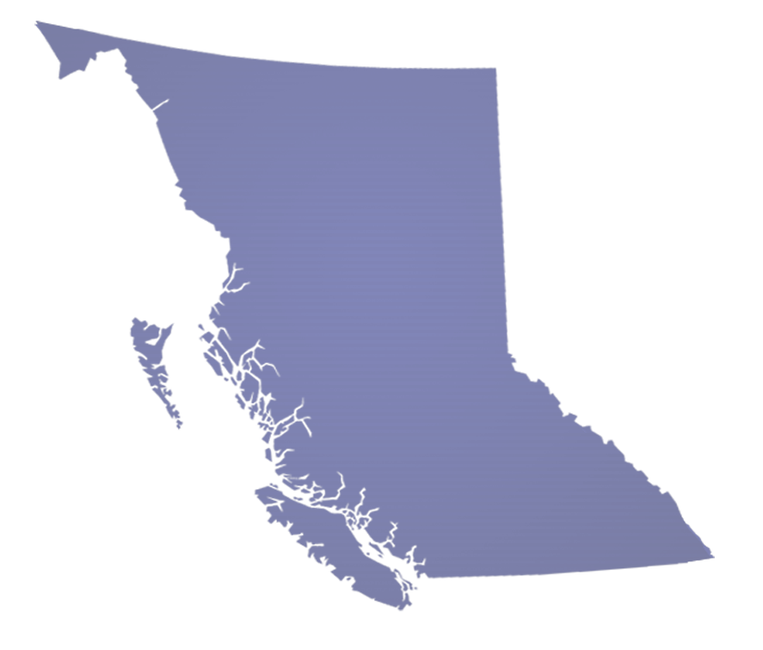
The Evolution of Environmental Management in BC: A Waste Management Perspective
Environmental Managers Association of BC
Jim Standen
Assistant Deputy Minister
BC Ministry of Environment

Slide 2
Outline
A changing world
New environmental paradigm
Energy and the environment
Government’s approach for energy

Slide 3
The Good Old Days

Slide 4
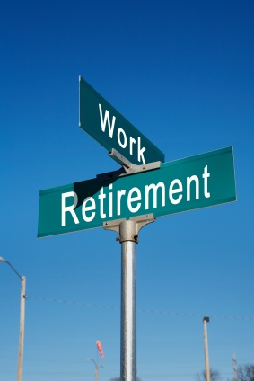
A Changing Social Landscape
URBANIZATION
FISCAL LIMITATIONS
DEMOGRAPHICS
COMPETING DEMANDS

Slide 5
Public Interest
Greater access to information – an educated populace
Rising public expectations
Perceptions of risk

Slide 6
Can’t Touch Everything

Slide 7
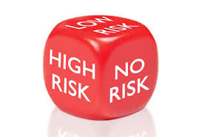
An Evolving Statutory Model
RISK BASED
INDUSTRY WIDE STANDARDS
PROFESSIONAL RELIANCE
NON REGULATORY APPROACHES
STRATEGIC PARTNERSHIPS

Slide 8
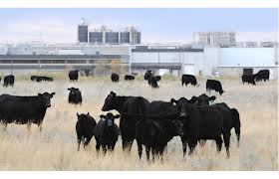
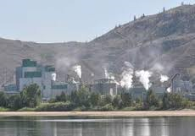
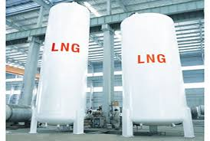
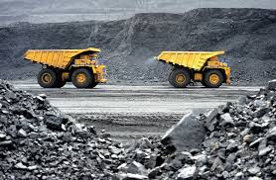
Resource Development

Slide 9
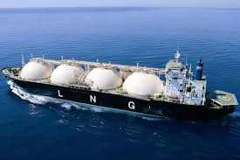
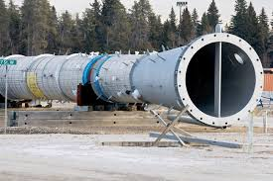
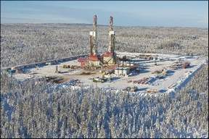
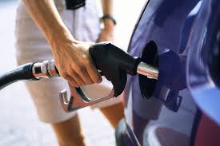
Hydrocarbons
 | Oil | Gas
Production | ü | ü
Conveyance | ü | ü
Processing | ü | ü
Retail | ü | ü

Slide 10
Role of Environment
Legislation/Policy Development
Social license
Investment Climate
Certainty
Predictability
Timeliness

Slide 11
ENERGY - A Complex Regulatory Landscape
Provincial Permitting/Regulation
EAO (reviewable projects)
OGC (wells, gathering, processing, transmission and liquefaction)
MOTI (transportation by truck/ship/rail)
Provincial Environmental Legislation/Policy
MOE
Federal Permitting/Regulation
NEB
Transport Canada
Federal Environmental Legislation/Policy
NRCAN
CEAA
DFO

Slide 12
Integrated Decision Making (IDM)
=

Slide 13
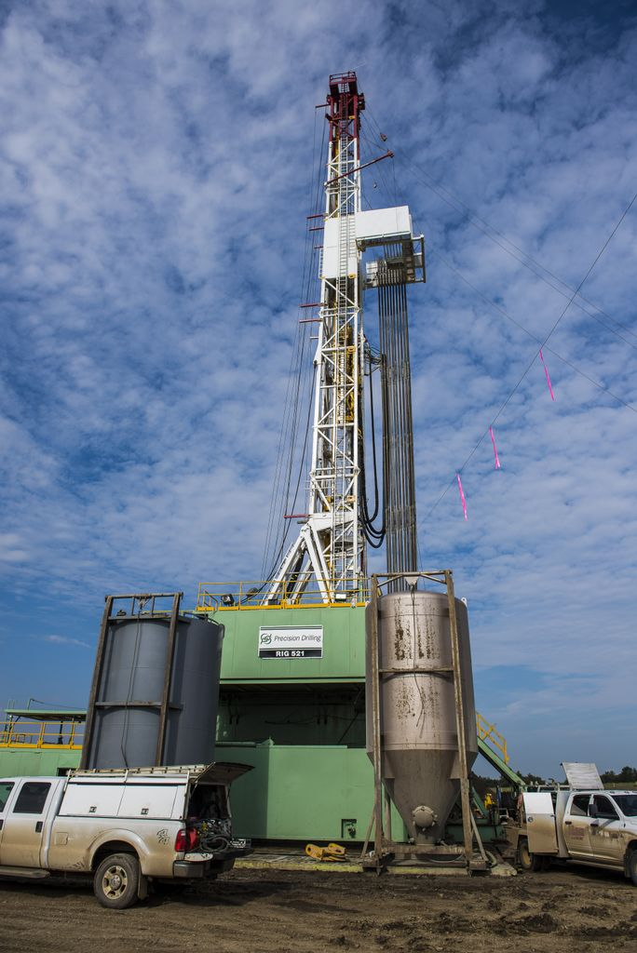
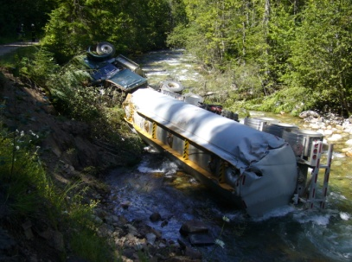
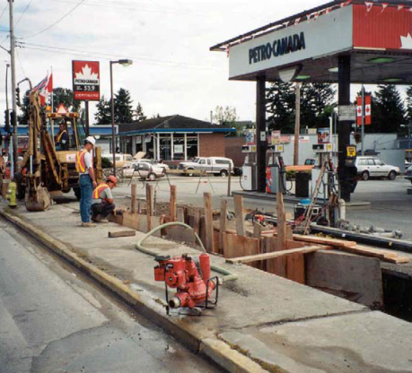
Energy and the Environment
Air – Natural Gas Processing
Spills – Pipelines/Rail/Truck
Water – Drilling/Hydraulic Fracturing/Cooling
Land Contamination – all activities

Slide 14
Air - LNG
Proactive regulatory review – new guidelines are under consideration for 2014.
Provide clear consistent guidance that industry wants - BC will meet or beat national air emission guidelines.
Address community and environmental health concerns – interim air quality objectives will reflect leading jurisdictions and current health science.

Slide 15
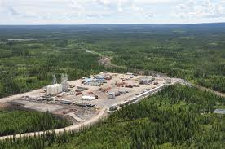
Air – Upstream/Midstream
Public concern over health/environmental impacts of oil and gas development
Production to meet LNG Projected Target of 83 MTPA is ~ 3x current levels
Flaring reduced by 38% since 1996 while gas production has increased by 74%
Northeast Oil and Gas Human Health Risk Assessment
Ambient Air Monitoring Program Introduced in 2012

Slide 16
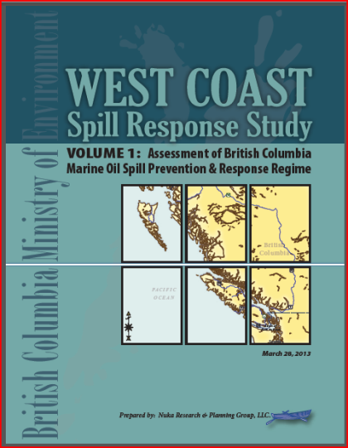
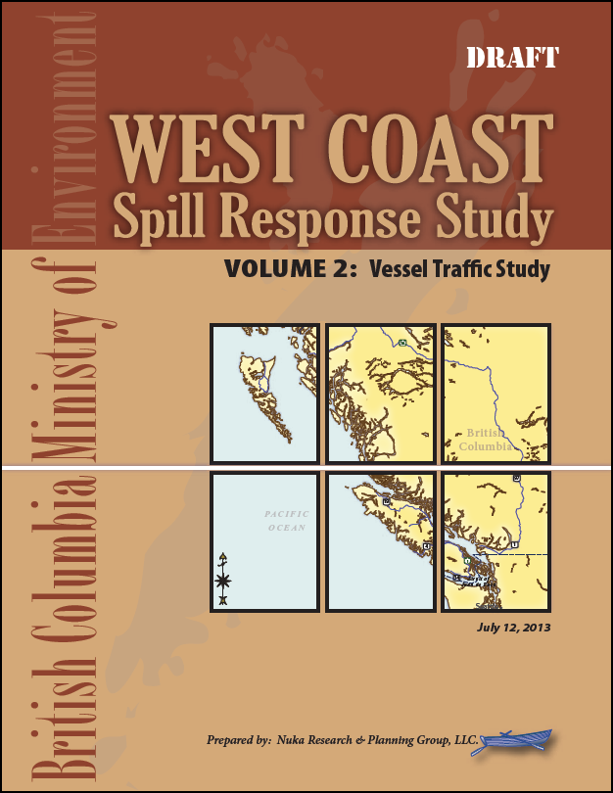
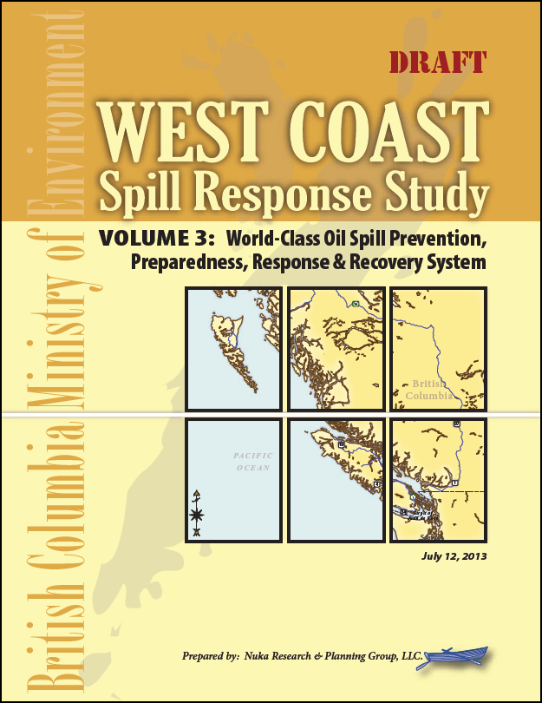
Five Conditions
World-leading marine oil-spill response, prevention and recovery systems.
World-leading practices for land oil-spill prevention, response and recovery systems

Slide 17
Spills
World-leading marine oil-spill response | World-leading practices for land based oil-spill response
INFLUENCING | LEADING
Exclusive federal jurisdiction | Shared Provincial (response to spills a Crown Land) and Federal (railway and pipeline regulation)jurisdiction
Province is working with Canada to see a world class regime implemented in BC | MOE is leading the development of a made in BC land based oil spill response regime
NUKA reports to provide foundation for our engagement with Canada | MOE Intentions Paper (along with submissions to NGP hearings) provides foundation for new development policy
Establishment of formal engagement with Transport Canada and Coast Guard | Spills Symposium (March 2013) and ongoing industry/government working groups. Strong desire by NRCan and Transport Canada to become engaged

Slide 18
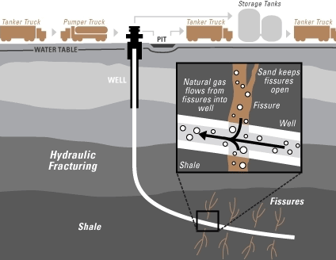
Water
Deep well disposal
Fracking fluid composition
Closed loop future?

Slide 19
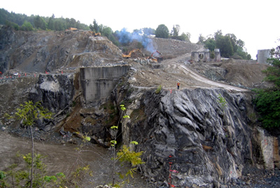
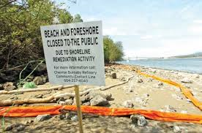
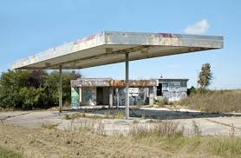
Land Remediation
Contaminated Sites Regulation:
Production – well sites/pits/
Processing – upstream and downstream/refinery
Retail – service stations

